Slide 1
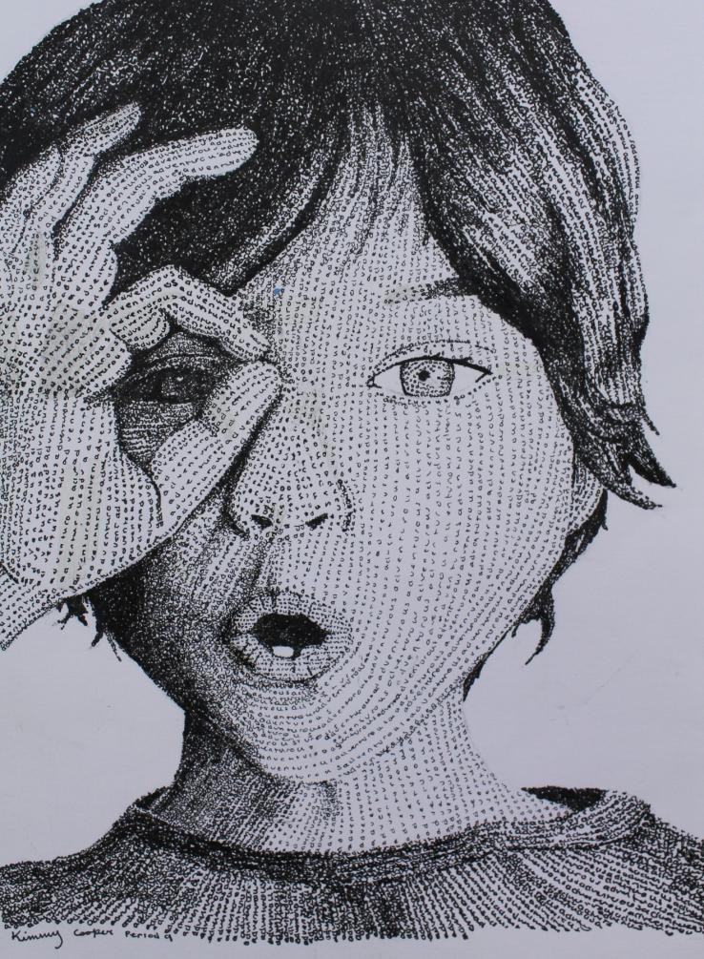
Cold Spring Harbor Art Department Curriculum
Andria McLaughlin
Chairperson K-12

Slide 2
Cold Spring Harbor
Art Department
Goose Hill Primary
Colleen Johnson
Lloyd Harbor Elementary
Ann McLam
West Side Elementary
Andria McLaughlin
CSH Junior High
Samantha Hayes
Colleen Johnson
CSH Senior High
Laura Cirino
Kristine Levy
Christine Oswald

Slide 3
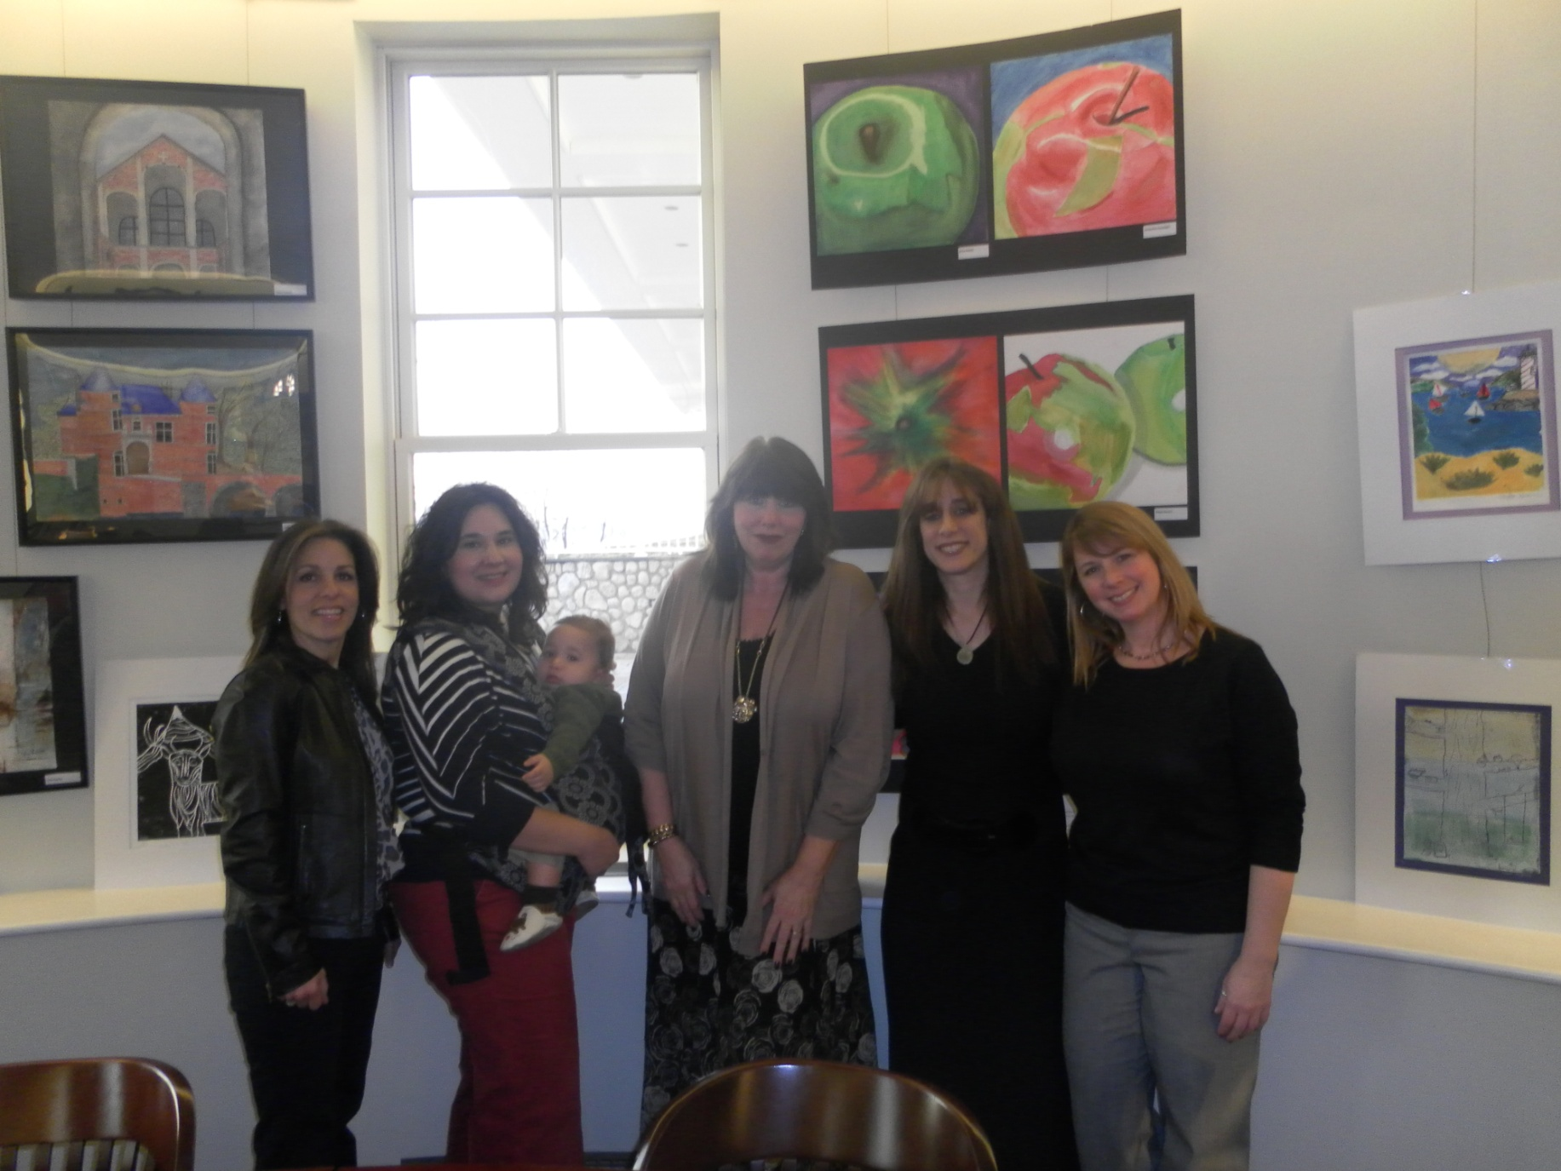
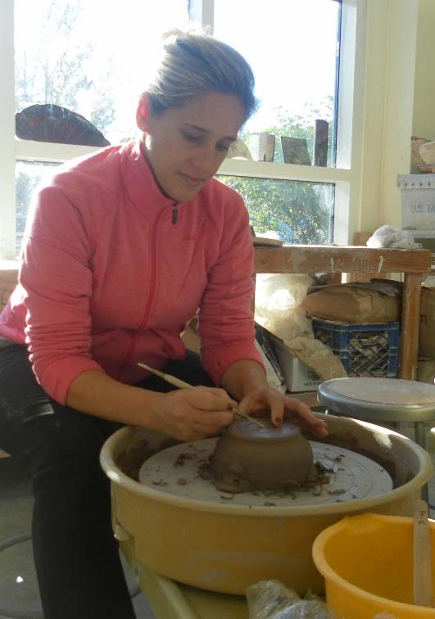

Slide 4
“Students who can identify the Elements of Art and Principles of Design and evaluate their role in the composition of a work of art will be better able to understand an artist's choices. They will be equipped to address whether a work of art is successful, and why”.
http://www.getty.edu/education/teachers/building_lessons/formal_analysis.html

Slide 5
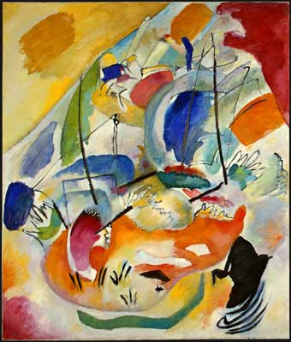
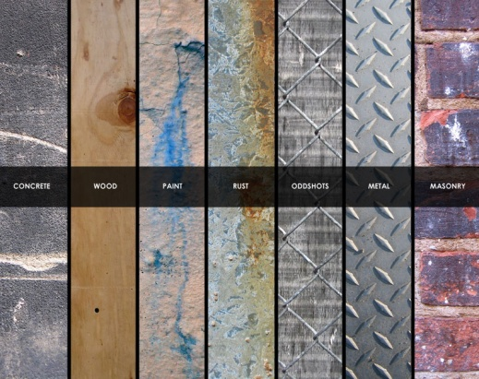
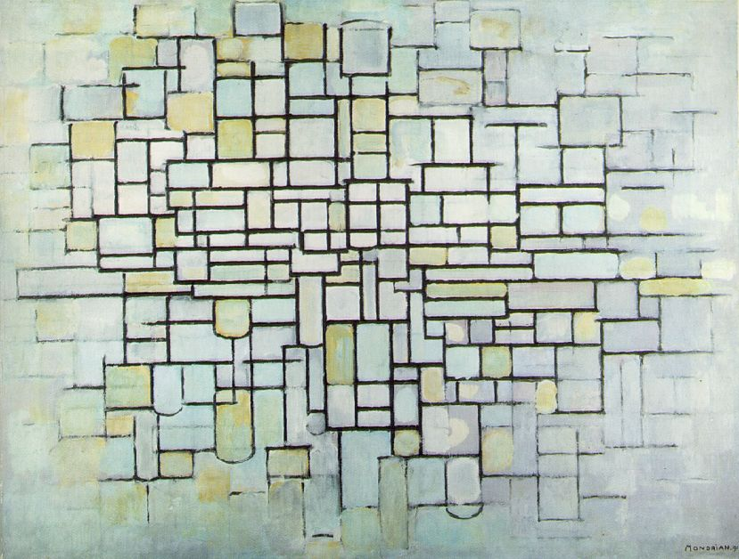
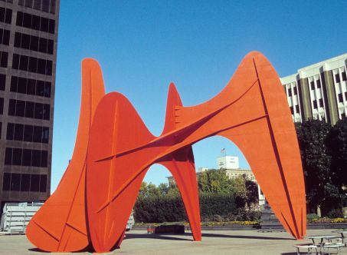
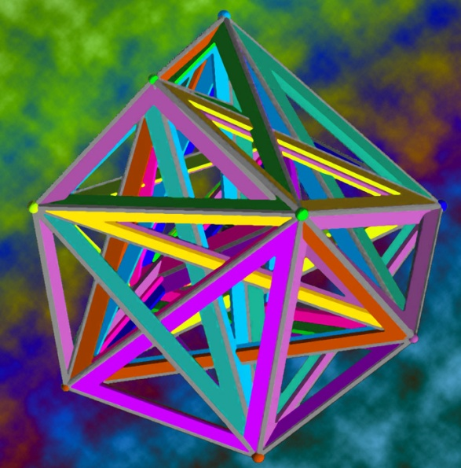
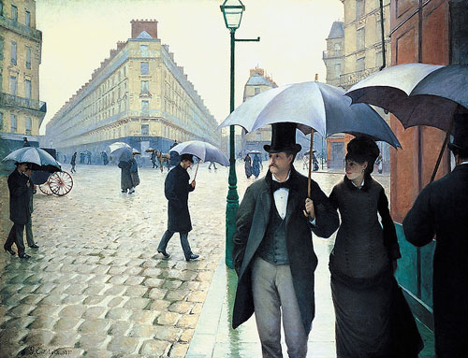
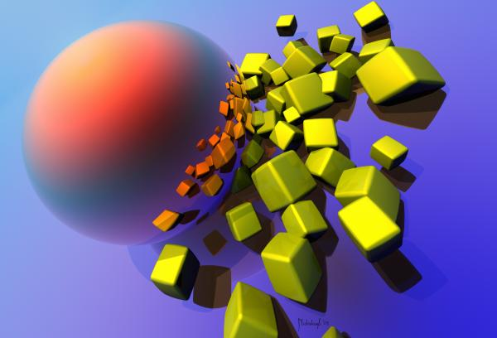
Elements of Art
Line
Shape
Color
Form
Texture
Space
Value

Slide 6
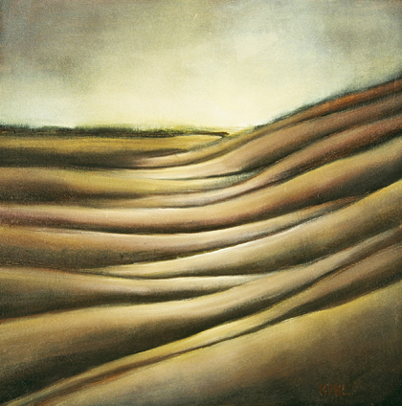
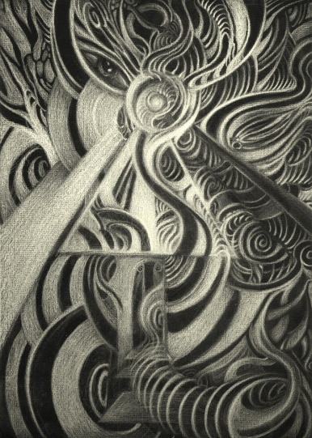
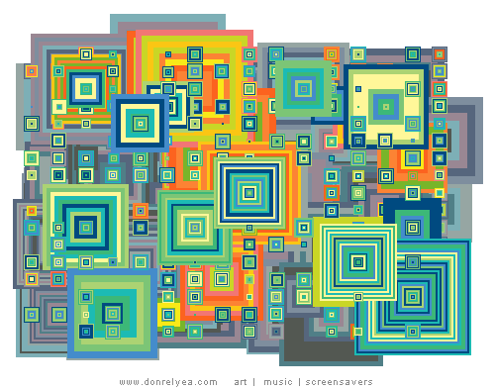
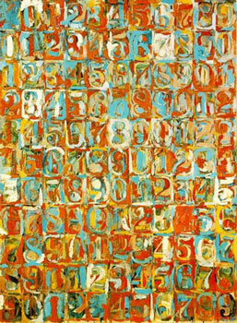
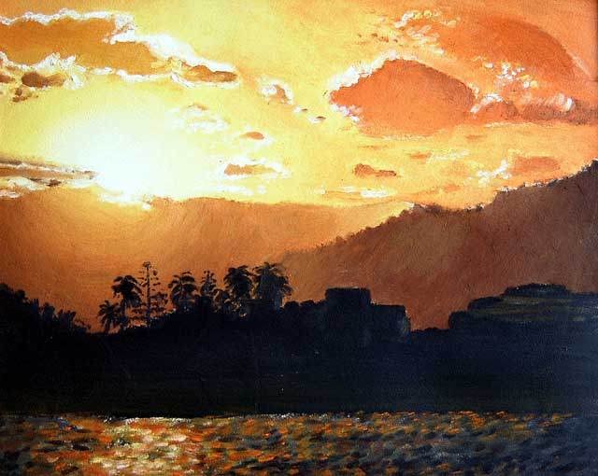
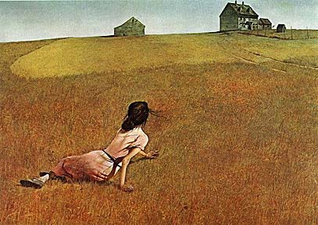
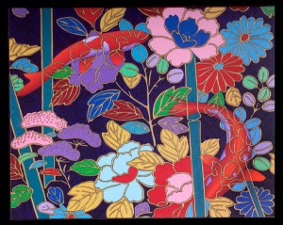
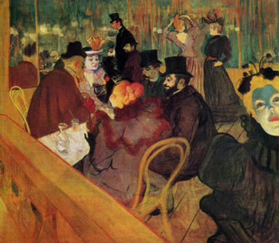
Principles of Design
Unity/Harmony
Emphasis
Balance
Proportion
Rhythm
Movement
Variety
Contrast
Repetition/Pattern

Slide 7
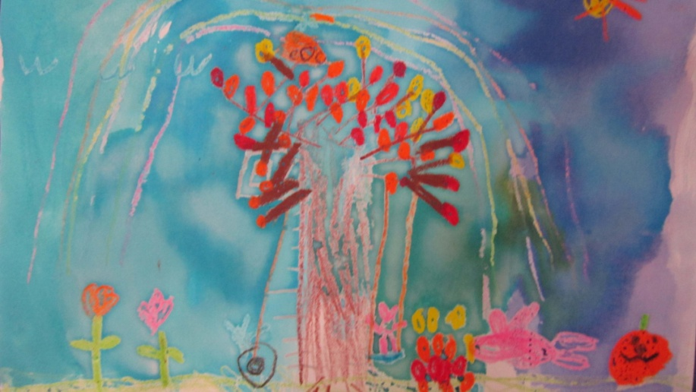
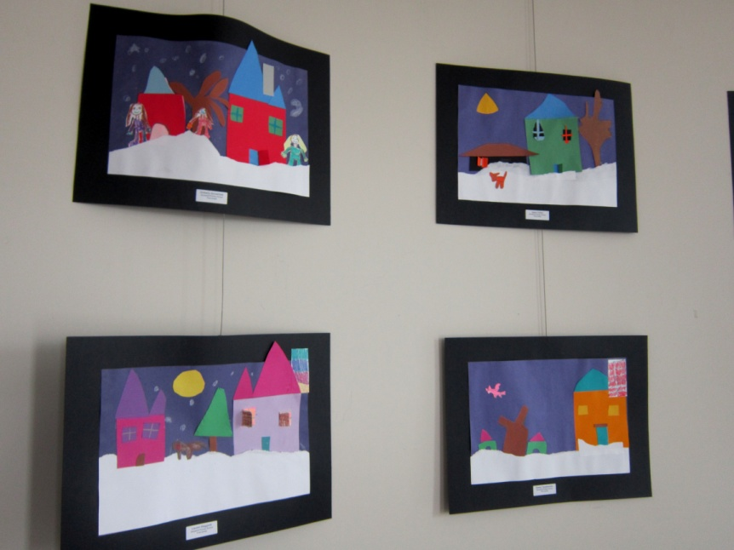
A Glance at
Goose Hill
Primary School:

Slide 8
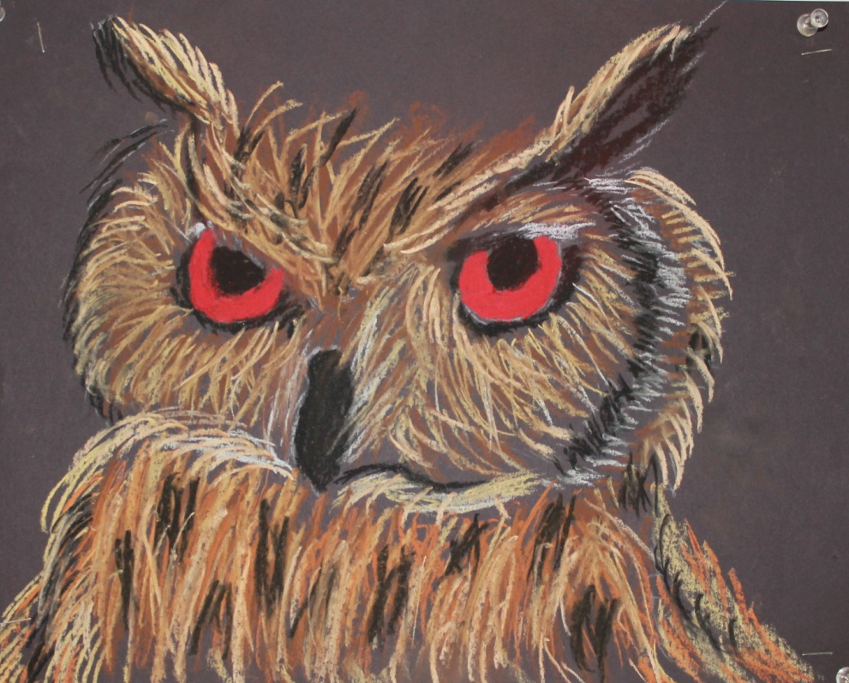
A Glance at
Lloyd Harbor Elementary School:

Slide 9
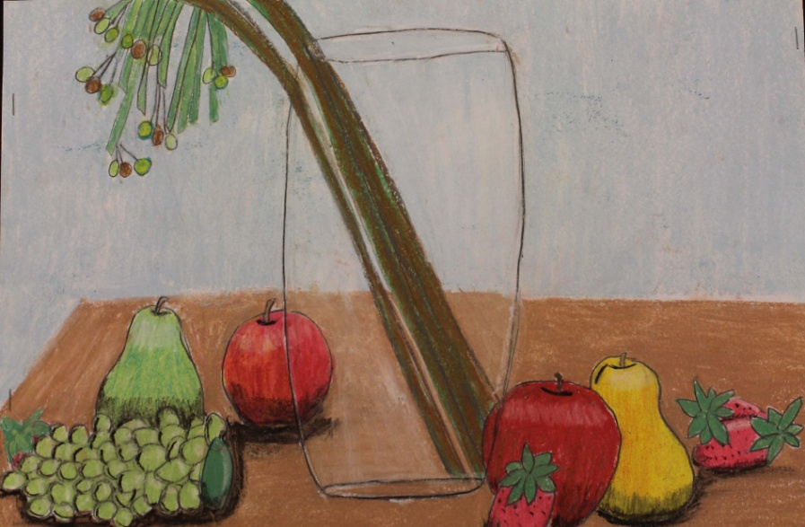
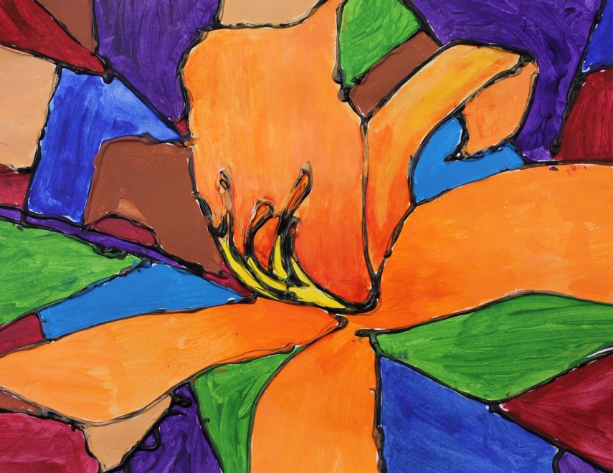
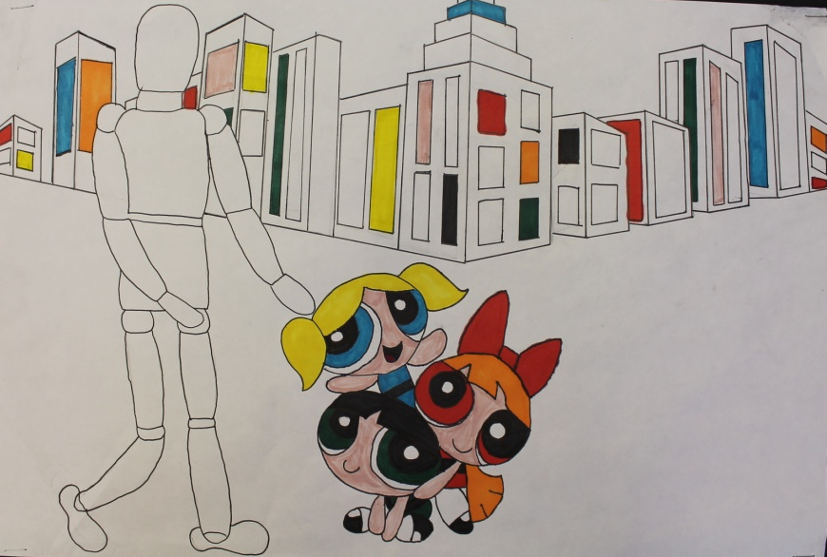
A Glance at
West Side
Elementary School:

Slide 10
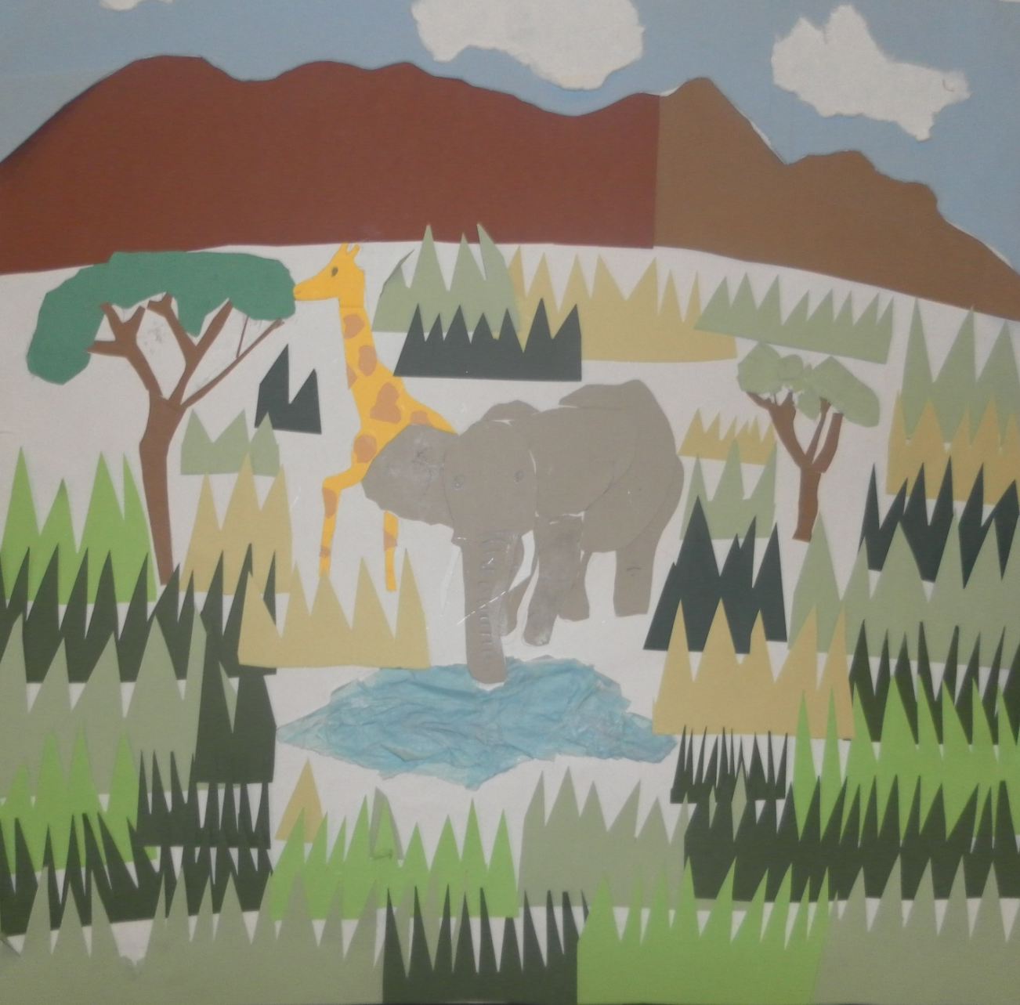
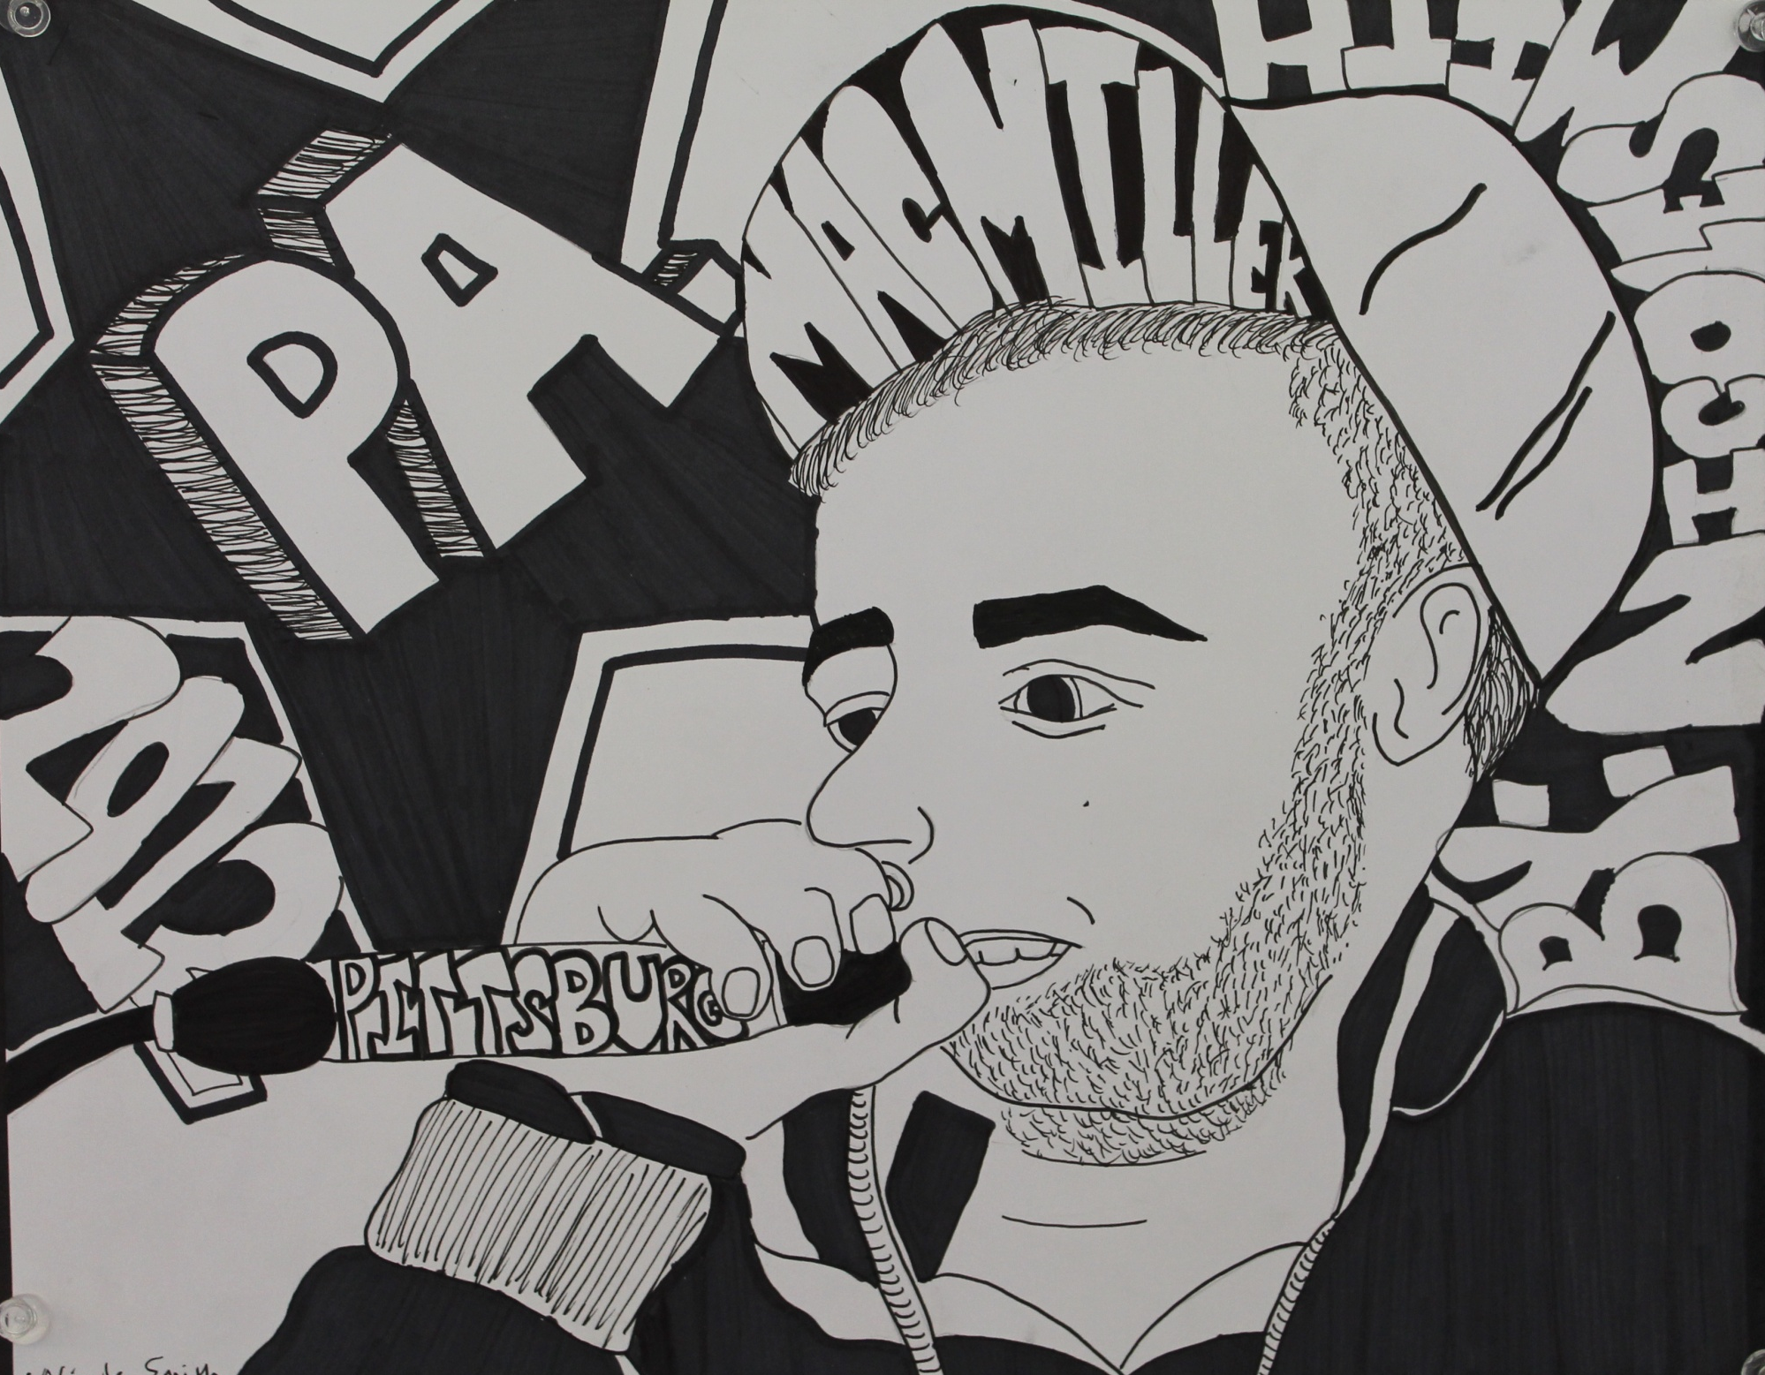
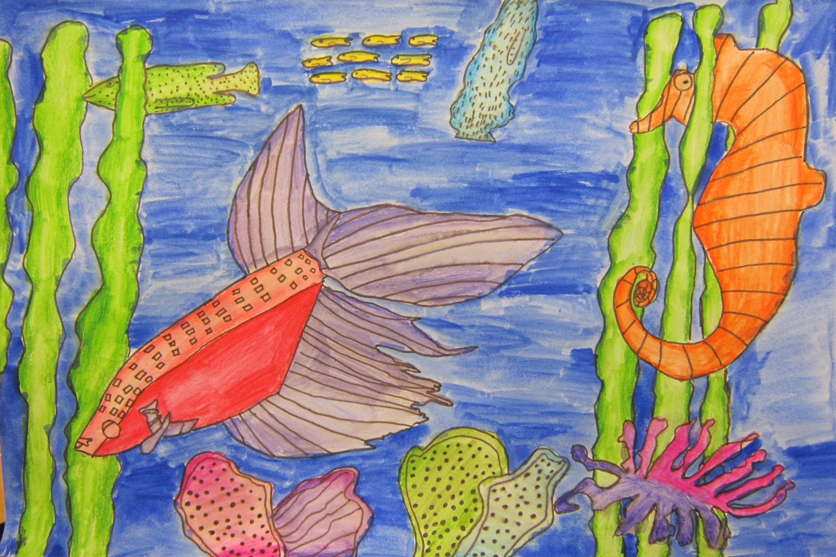
A Glance at
CSH Junior High
School:

Slide 11
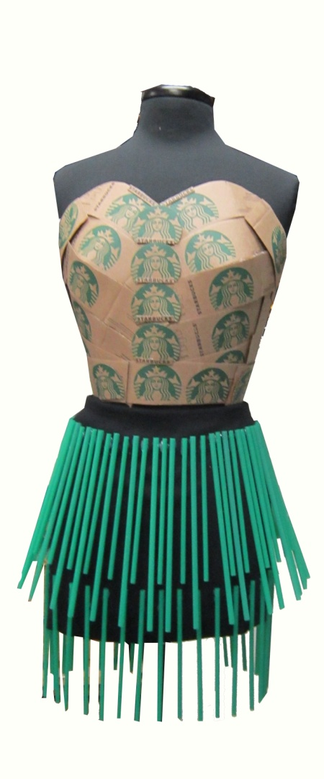
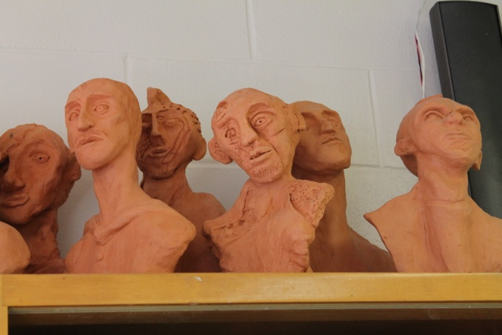
A Glance at
CSH Senior High
School:

Slide 12
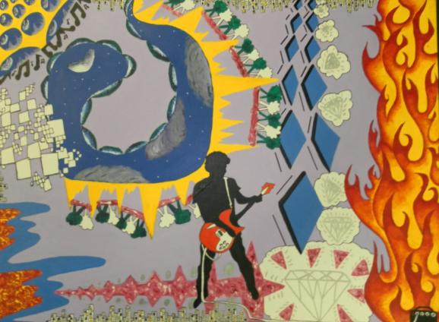
Studio Art
Intro to Drawing and Painting
Advanced Drawing and Painting
Senior Project
2D Design AP
Photography AP
Drawing AP
AP Art History

Slide 13
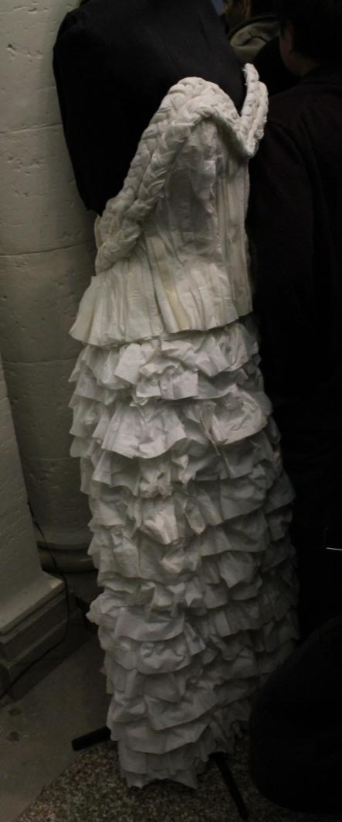
Studio Art
Introduction to Fashion Design
Advanced Fashion
Design
Senior Fashion
Collection

Slide 14
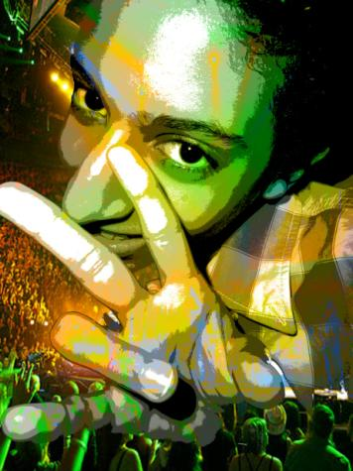
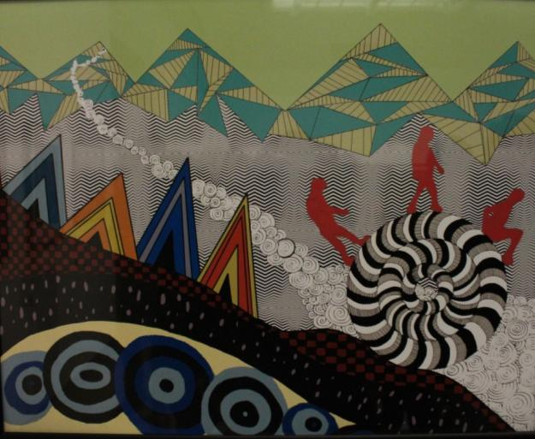
Media Arts
Digital Imaging
Web Design
Visual Storytelling
Introduction to
Graphic Design

Slide 15
Collaboration between schools:
Art teacher, Laura Cirino and Art Club students at the high school created this 18 foot mural for the Lloyd Harbor Elementary school cafeteria.

Slide 16
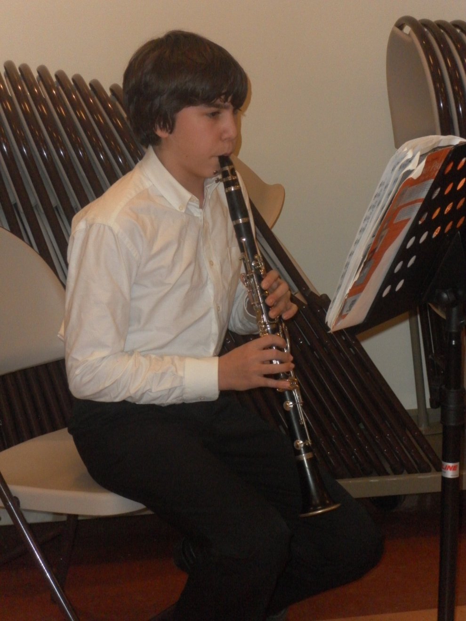
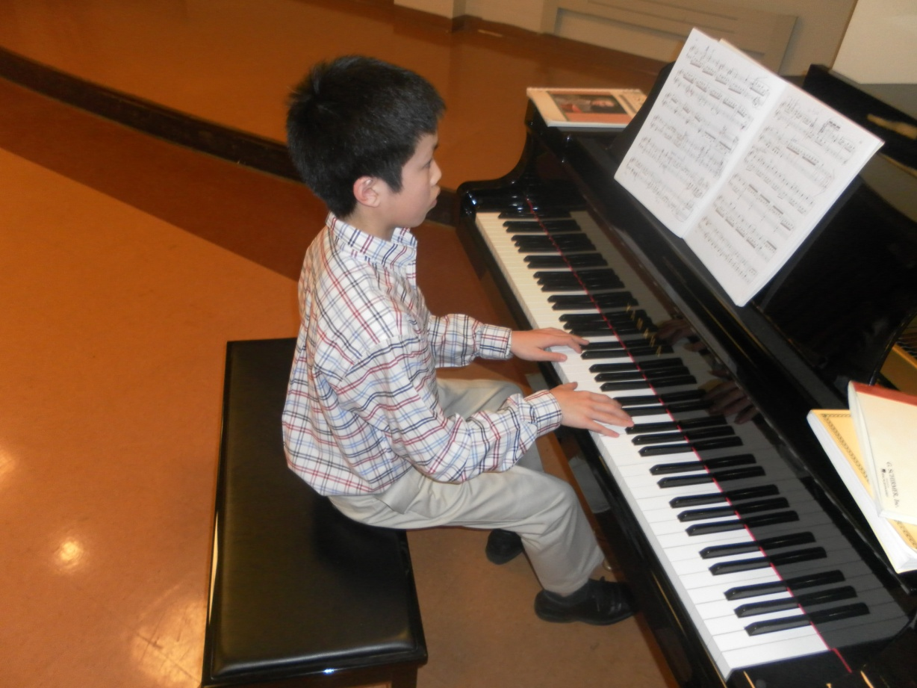
Collaboration between disciplines:
Art and Music

Slide 17
An Artist in residency gives students and teachers opportunities to learn new and exciting ways to create interesting art.

Slide 18
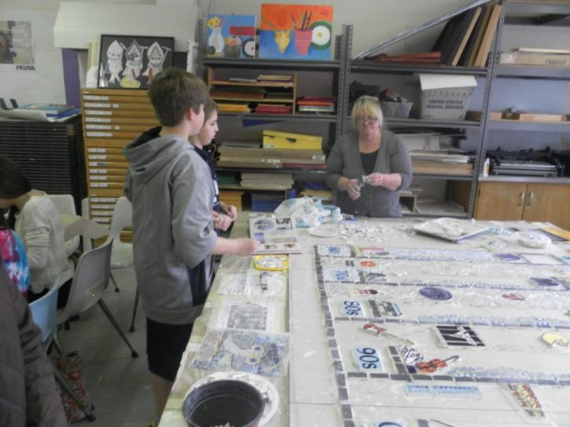
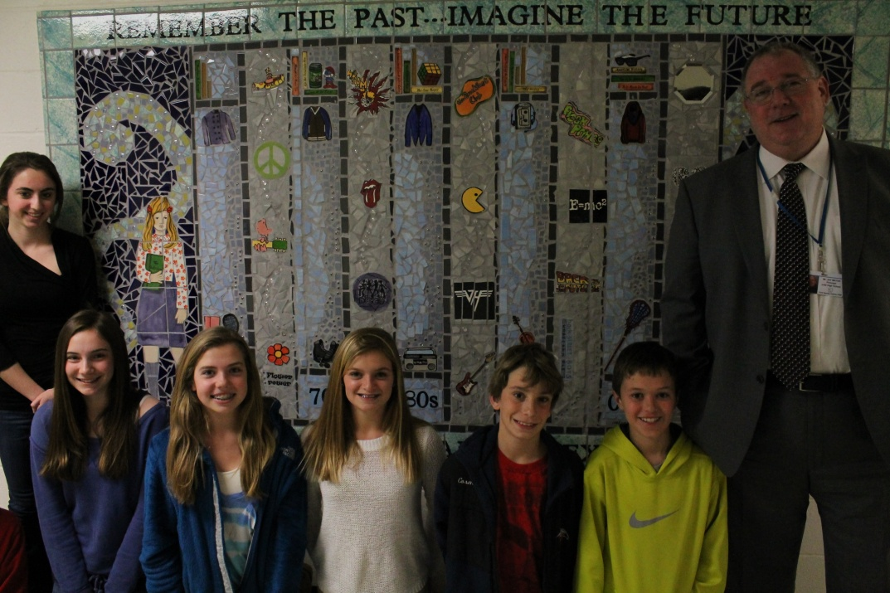
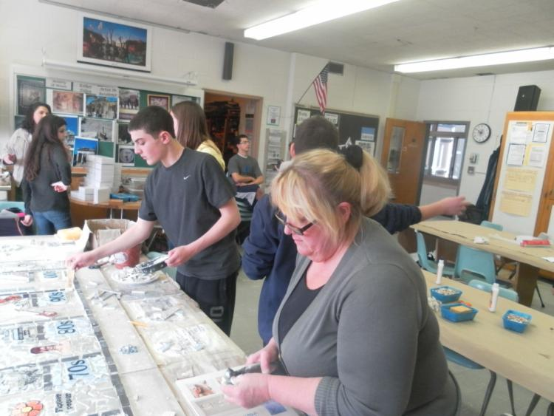
Esther Tollen
Mosaic Artist
2011/2012

Slide 19
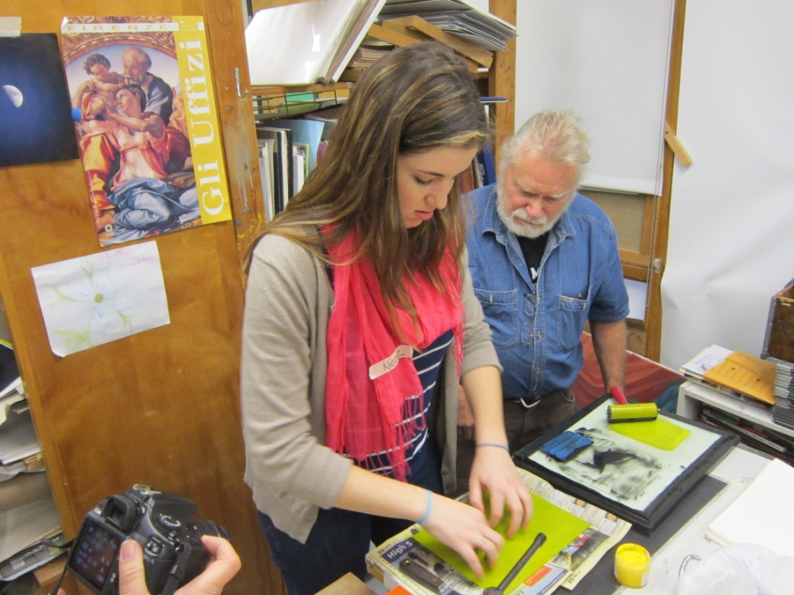
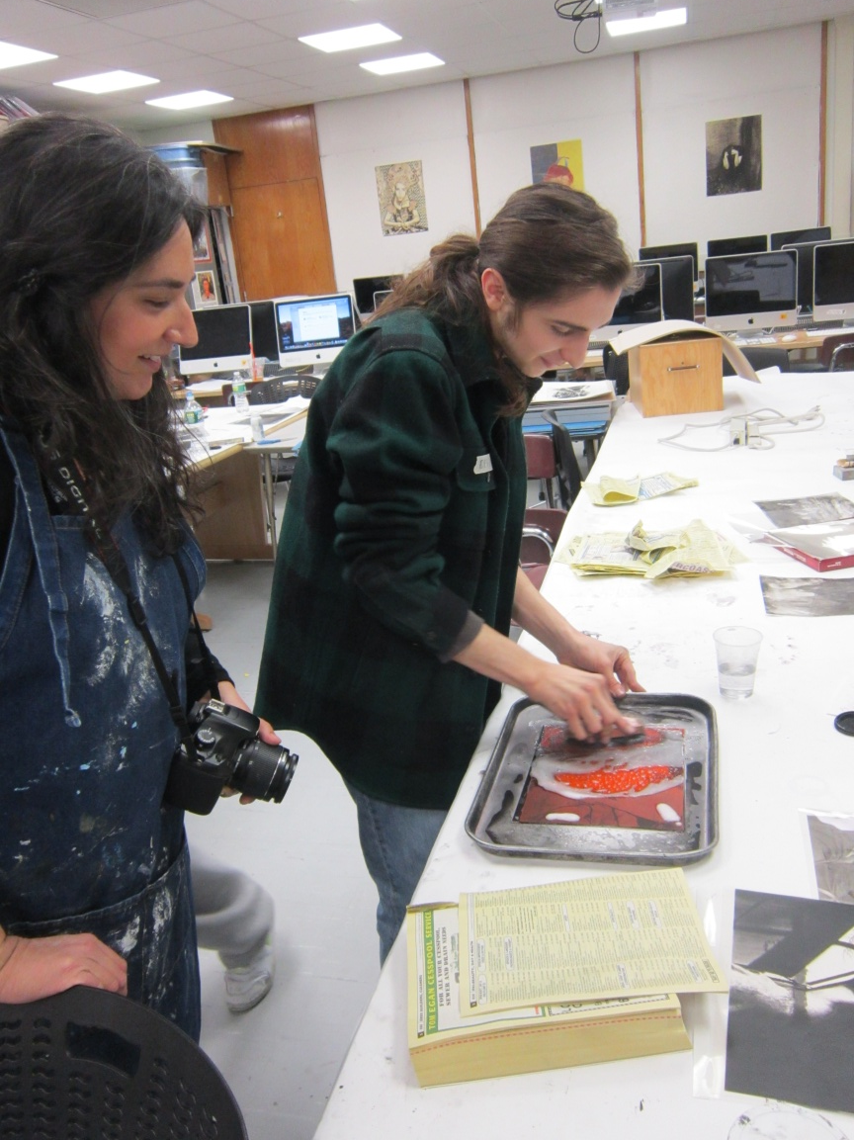
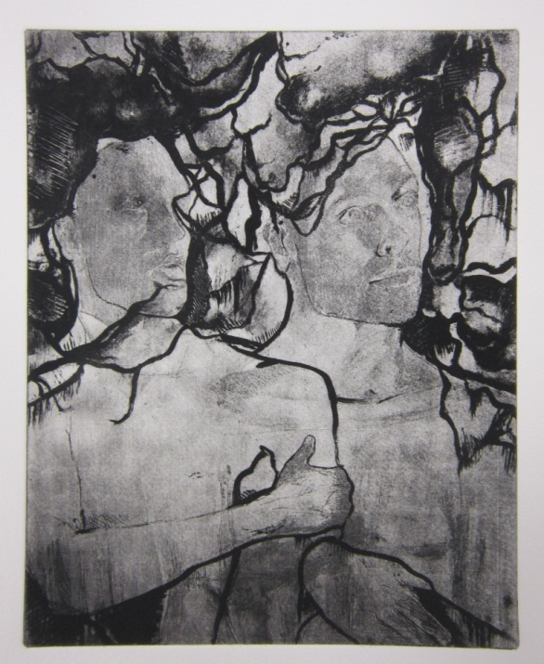
Dan Welden
Solarplate artist - 2013

Slide 20
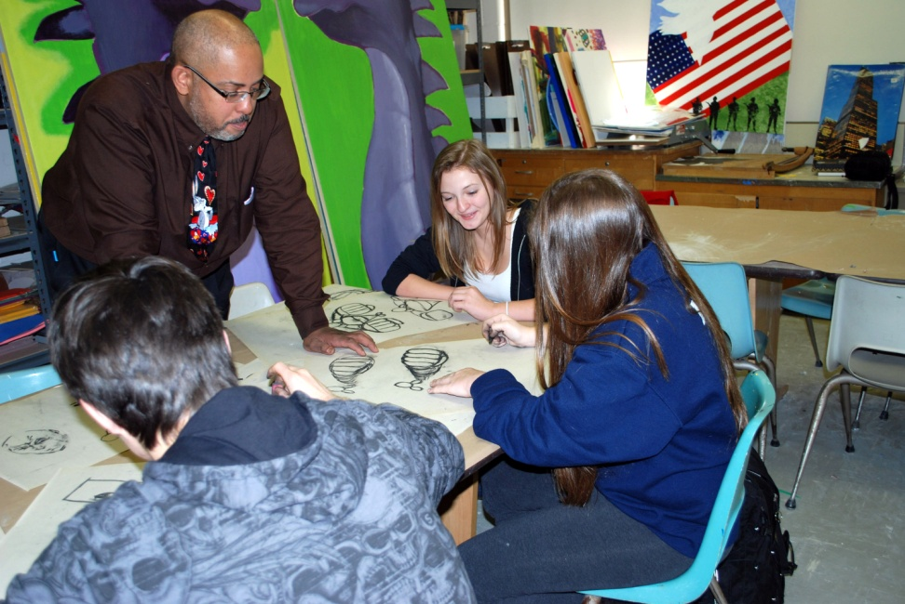
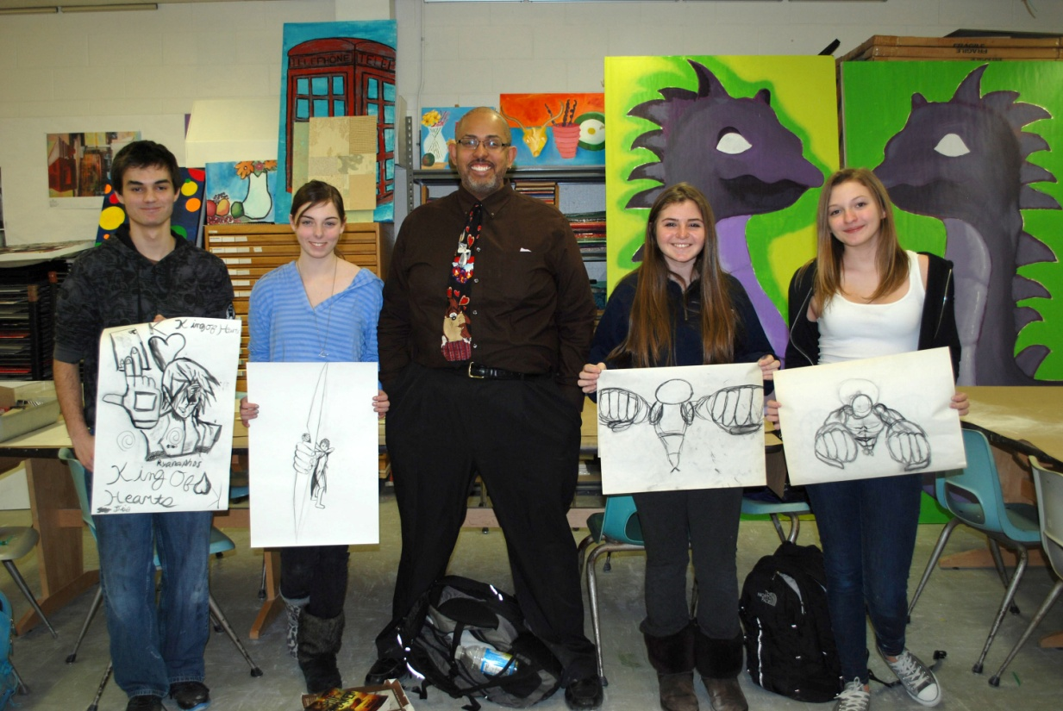
Marcus McLaurin
Cartoonist
2013

Slide 21
CSH teachers
strive to learn new techniques
every day.
Workshops at the
Huntington Art League

Slide 22
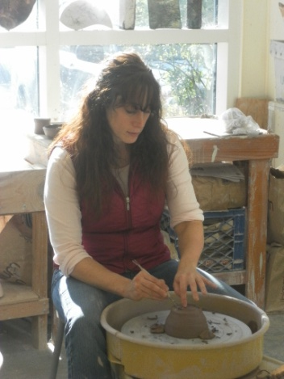
Andria McLaughlin
West Side Elementary
Grades 2-6

Slide 23
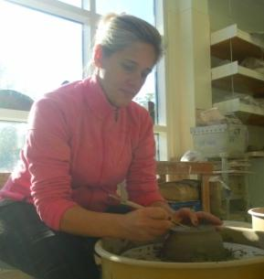
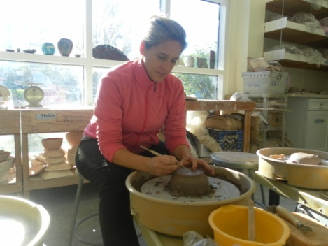
Samantha Hayes
CSH Junior High
Grades 7 & 8

Slide 24
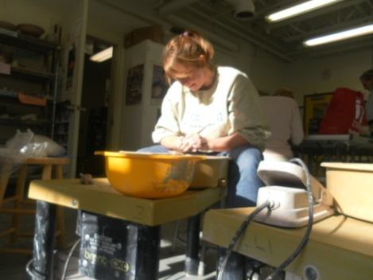
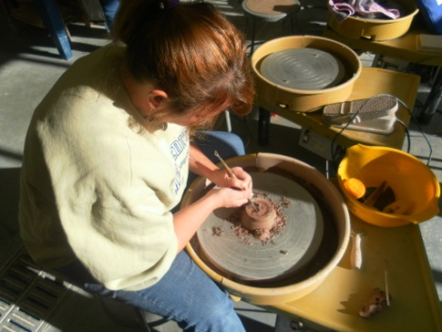
Colleen Johnson
Goose Hill Primary
Grades K-1
CSH Junior High
Grades 7

Slide 25
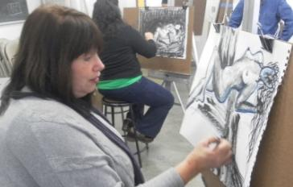
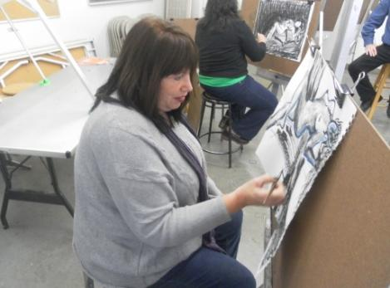
Laura Cirino
CSH High School
Grades 9-12

Slide 26
Christine Oswald
CSH High School
Grades 9-12

Slide 27
Ann McLam
Lloyd Harbor Elementary
Grades 2-6

Slide 28
Kristine Levy
CSH High School
Grades 9-12

Slide 29
Every child is an artist. The problem is how to remain an artist once we grow up.
~Pablo Picasso

